Slide 1
Remote desktop application using tcp/ip
Team:
Sai Sumanth Goud Parakala
Manideep Jagadhabi
Rushil Rao Koulammagari

Slide 2
Introduction
This Project is based on TCP/IP Socket Based Client-Server Protocol Which Is Used For Remote Desktop Application Communication Between Server And Client.
The task at hand entails creating a client-server architecture in which the server serves as the remote desktop and directs interactions with various remote desktop clients.

Slide 3
Cont…
The application is designed to be simple and easy to use, with a command-line interface that enables users to execute a variety of remote desktop functions.
The users can connect to a remote computer and access its files.
One of the key features of the remote desktop application is its ability to provide a secure connection between the user and the remote computer.

Slide 4
CONNECTION ESTABLISHMENT
The client initiates a TCP connection by sending a connection request to the server
The server listens for incoming connection requests and accepts them
A three-way handshake process is performed to establish a reliable connection between the client and server
The server receives the messages and processes the data contained in them.

Slide 5

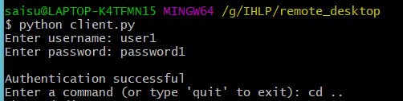
Cont…

Slide 6
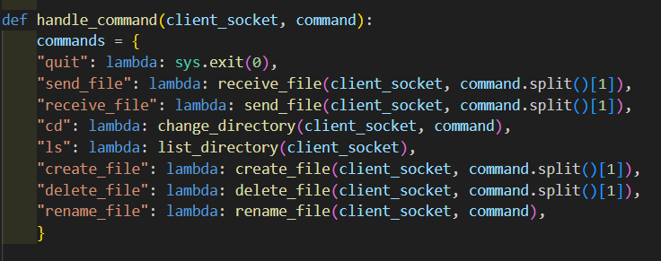
Features

Slide 7
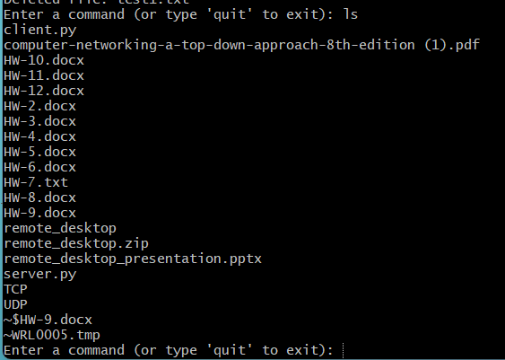
Cont…
Remote Files Access:

Slide 8

Cont…
File Transfer: (Send/Receive File)

Slide 9
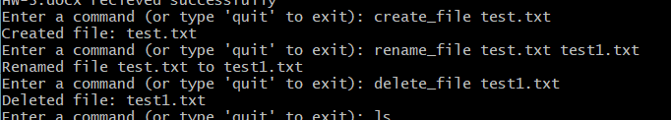
Cont…
CRUD Operations:

Slide 10
conclusion
In summary, the remote desktop application developed using socket programming is an efficient and reliable tool for remote access and control of a computer over a network.
To ensure the security of the application, user authentication has been implemented, ensuring that only authorized users can connect to the server.
The file transfer feature allows users to transfer files between local and remote computers, making the application more versatile and useful for different purposes.
In the future, additional features such as encryption and multi-factor authentication could be added to enhance the security of the application further. Additionally, the application could be extended to support multiple platforms, such as mobile devices, making it more accessible and versatile.

Slide 11
Thank you

